Slide 1
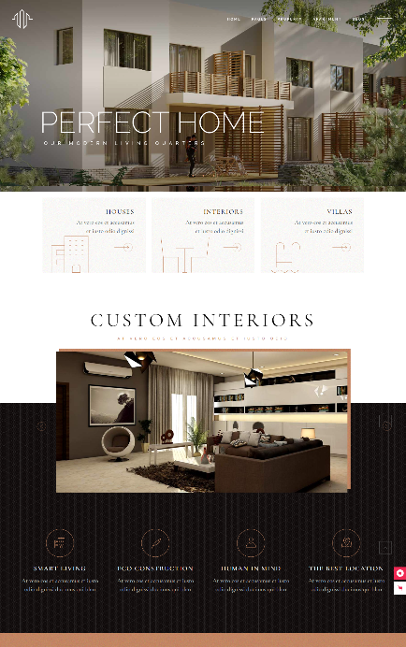

Project Proposal
Website CiptaBangun Karya
Website Company Profile Single Property
by agendakota

Slide 2
About us (Socialgeek.id)
is an application and information systems development company based in Surabaya. Since its establishment, various projects have been entrusted and we have successfully completed them well. In completing each project, we rely on a team that is professional, dedicated, and has high technical and analytical skills so as to be able to solve a variety of challenges and problems.
Vision Becoming World Class Technology based Solution Provider in Indonesia
Mission Providing long term Innovative solution using technology for better and modern Indonesia.

Slide 3
Competency
User Oriented Experience Design
Our team has proven competencies to create solution in many aspects of technology, such as:
User based UI & UX,
Complex and integrated web-based application,
Interactive & Intuitive Mobile Application,
IOT and Technology Implementation for specific purposes.
Technology Solution
IOT Implementation
Integrated Web-based application
Interactive Mobile Application

Slide 4

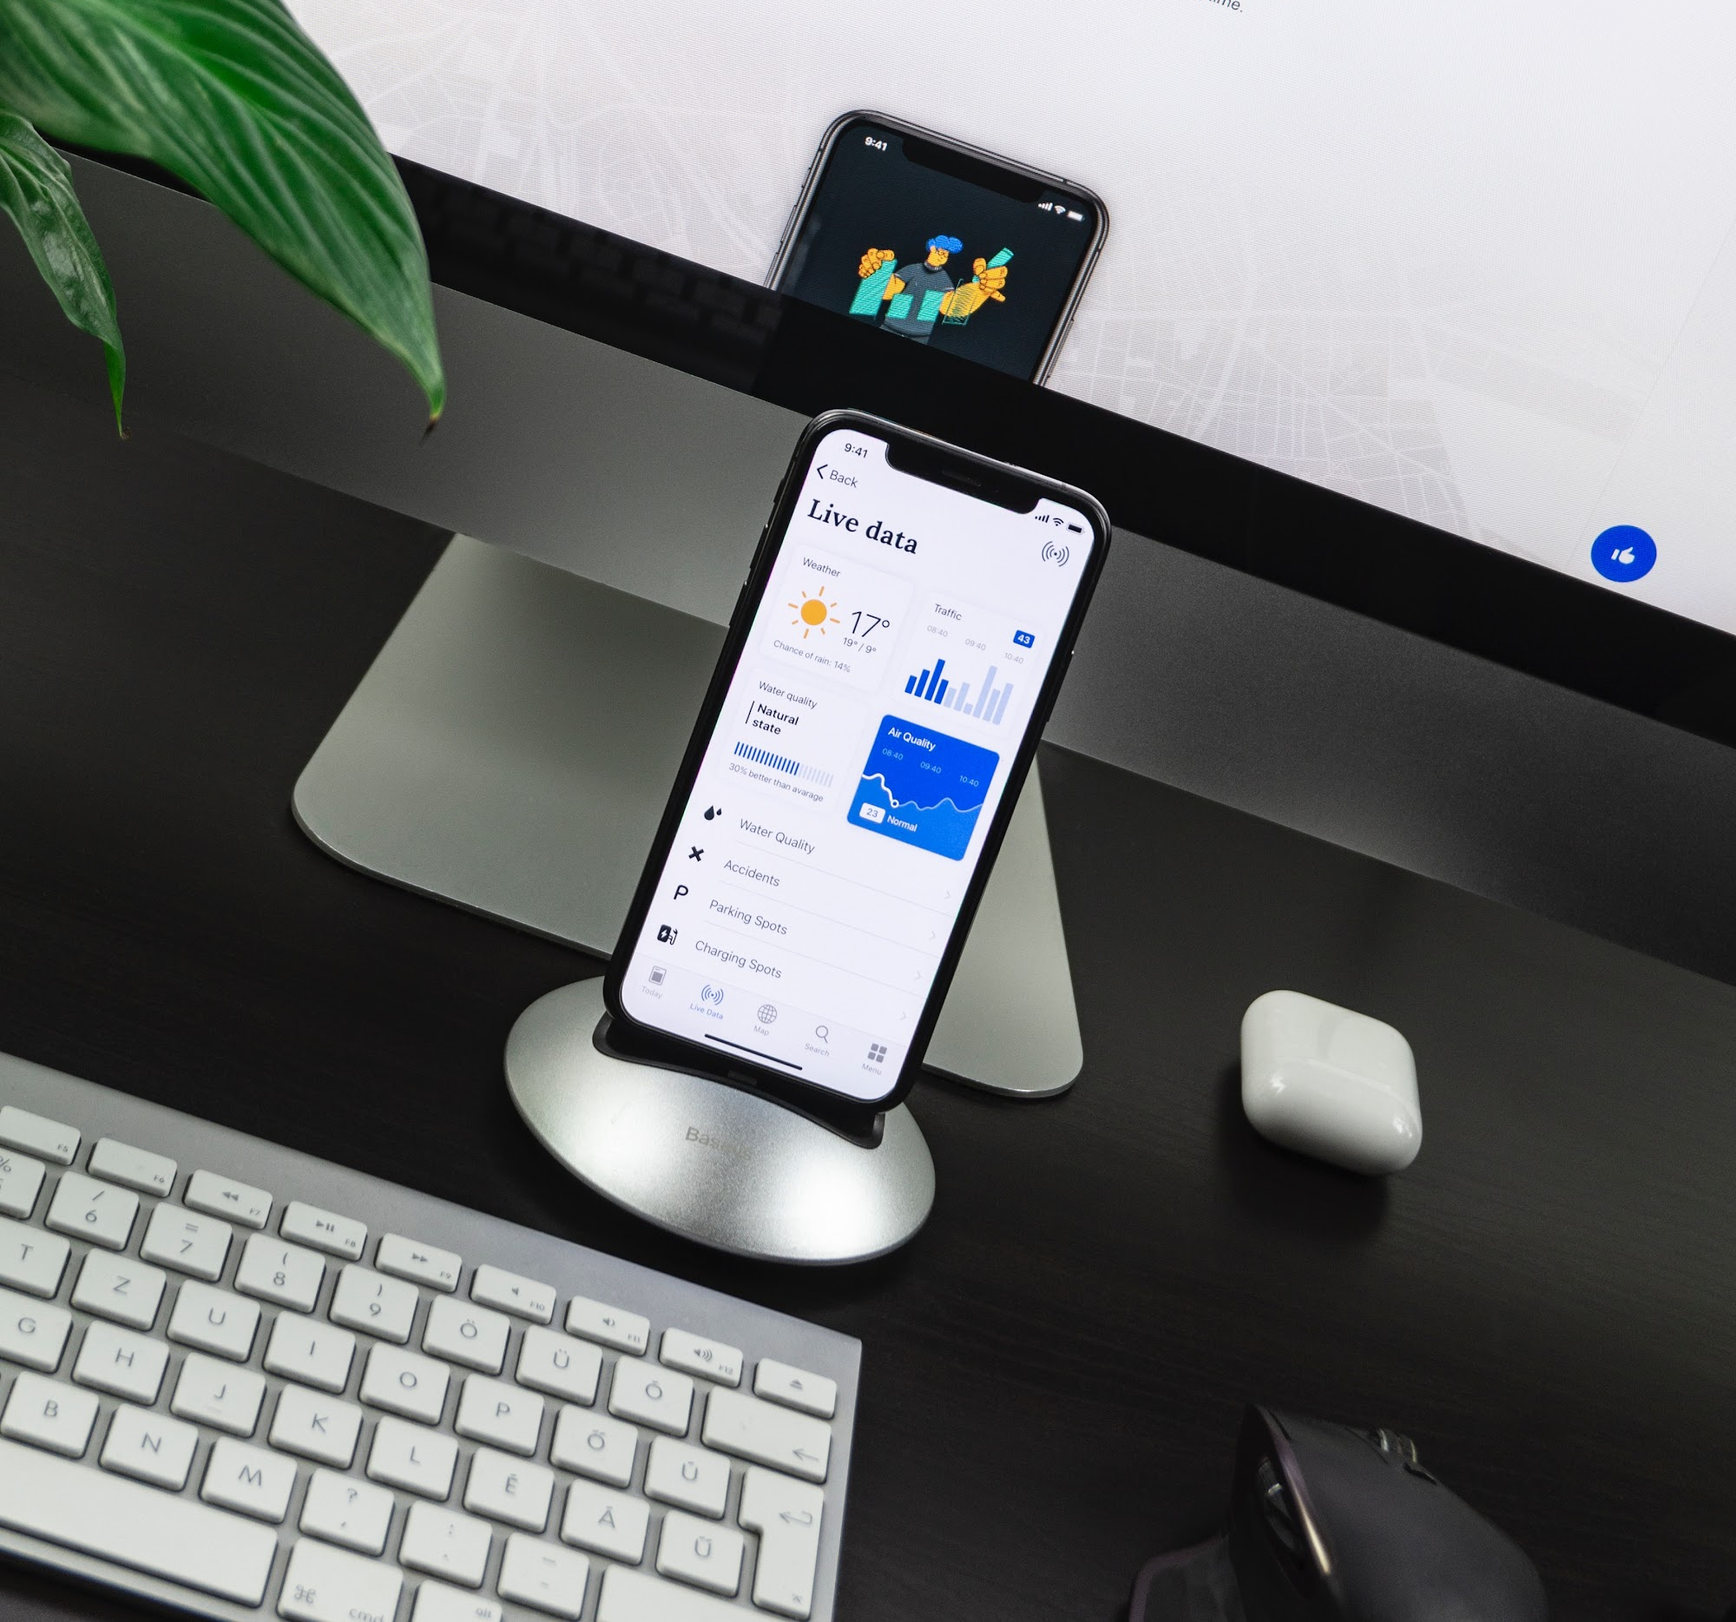

Our Services
Integrated Information System Development
We are able to develop specific information system needed by clients
Mobile App Development
We have experienced engineers and designers to develop IOS and Android Application.
Startup Solution
We can be the best partner for startup owners to develop a product using pay-as-you-need services

Slide 5
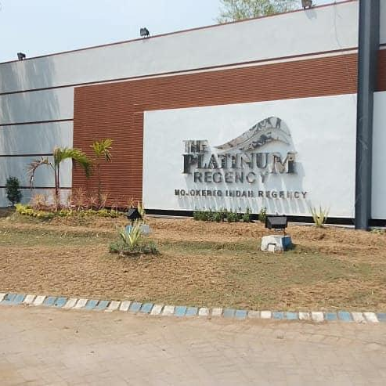
Project Quotation
Website Company Profile
Single Property
www.ciptabangunkarya.com

Slide 6

Scope of Work
Create system Website Company Profile , About Company, Services, News dan Event , Schedule Meeting, Flooring Plan,
We provide our services with pricing schemas for the development of the software.
Technology :
Cloud Server
CMS Wordpress
PHP Myadmin Database
PHP Framework
Chrome Web Browser

Slide 7
Features
Dashboard
Front End
Dashboard Post Article / News
Dashboard
Site Kit
Pages Static
User Management
Setting Profile
Setting Event
Schedule Meeting
Setting Gallery
About us
Services
Floor Room
Event
Gallery
News
Facilities
Contact

Slide 8
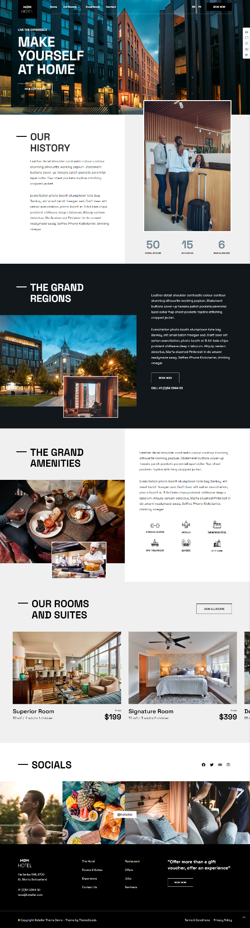
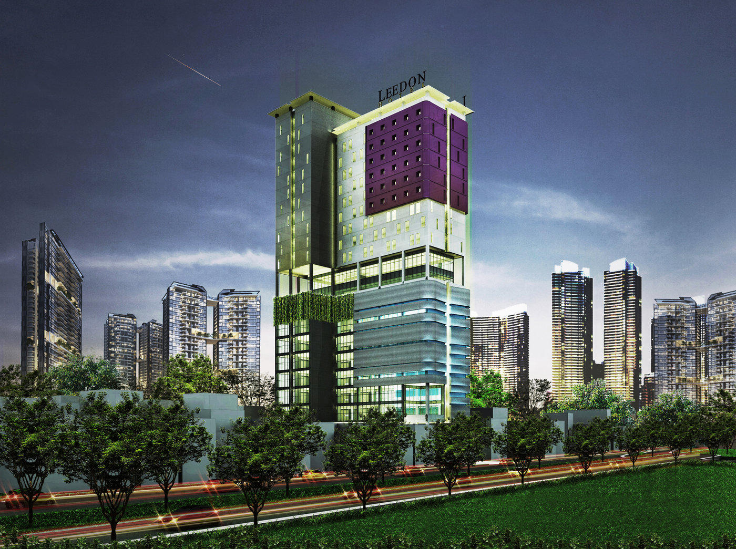
Front end Website Company Profile, News & Event, Promo & Schedule
CiptaBangun Karya dapat menampilkan Profile Company, Produk, Fasilitas, Schedule Meeting, berita terbaru hingga event list yang akan datang

Slide 9
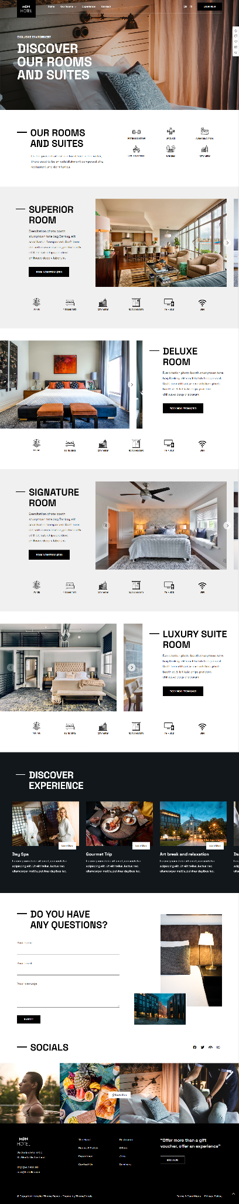
Home Type Display
User dapat melihat Room display dari Produk Ciptabangun Karya satu-persatu yang di nge-Link ke Halaman informasi, promosii, hinggal atur jadwal pertemuan dengan tim Marketing

Slide 10
Timeline
Development Finished
User can expect trial with entire systems. Trial and error phase.
Start Development
Backend Developer will start create core system.
Frontend Developer start Implementation Theme
Day14
Day 1
Day 7
Integrating with Front end
After Backend Developer fixed the core system, front end developer integrating with core system.

Slide 11
Pricing
To complete all the development process of Platform Directory , there will need at least 14 days of work with the following details:
Domain .com
Cloud Server by IDCloud Host
Theme Implementation
Backend Development
Front End Development
Integration
Trial & Testing
Revision
Training
IDR 3.500.000,-

Slide 12
Maintenance ++
Restarting virtual Machine
Backup Files
Pacthing System
Clearing logs and archiving logs
Update Server
Update Plugin
Update CMS
Create article Content - 1 News Content / day
Content Design
Digital Ads Placement
Search Engine Marketing
IDR 500K
Per-Month
*Exclude Budget Ads (Iklan)

Slide 13
Pricing Detail
No | Detail | Pricing | Remark
1 | Package Website Company Profile & Booking Schedule Meeting | Rp 2.850.000 | One time
2 | Domain ciptabangunkarya.com | Rp 275.000 | Per year
3 | Server RAM 2GB, 2GB Storage | Rp 375.000 | Per year
4 | Maintenance | Rp. 500.000,- | Per-Month
 | Total | Rp. 4.000.000,-

Slide 14
Contact
Thank you for your willingness to see this quotation. We hope that this collaboration can take place in the near future. Further information can contact us via:
Email : socialgeek.id@gmail.com Website : https://socialgeek.id
Phone : +62 851 7407 2902
by agendakota

